Slide 1
COUNTING OF CELLS USING IMAGE PROCESSING BY CV2
Presented by
Shanthosh.M
Gowri Shankar
Anirudh

Slide 2
Modules required
CV2 (for image processing)
Numpy (Numerical Python)
sys (for accessing the intrepreter)
How does the cell counting process works?
Many approaches, algorithms & modules can be used.
Basically, by Image Thresholding and Contour generation are used here

Slide 3
Some basic Introduction
Binarization is the process of converting a pixel image to a binary image.
Image thresholding is a simple, yet effective, way of partitioning an image into a foreground and background. This image analysis technique is a type of image segmentation that isolates objects by converting grayscale images into binary images.
Edge(Contour) detection is an image processing technique for finding the boundaries of objects within images. It works by detecting discontinuities in brightness. Edge detection is used for image segmentation and data extraction in areas such asimage processing, computer vision, and machine vision

Slide 4
Whereas in CV2 module, contour is used to draw any shape provided you have its boundary points. Its first argument is source image, second argument is the contour which should be passed as a Python list, third argument is index of contours.
cv2.drawContours Function is used

Slide 5
The Watershed Transformation
Any greytone image can be considered as a topographic surface.
If we flood this surface from its minima and, if we prevent the merging of the waters coming from different sources, we partition the image into two different sets: the catchment basins and the watershed lines.
If we apply this transformation to the image gradient, the catchment basins should theoretically correspond to the homogeneous grey level regions of this image.
Here marker-controlled watershed is used

Slide 6
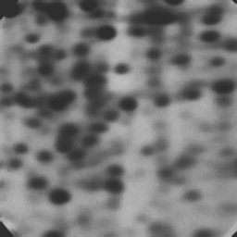
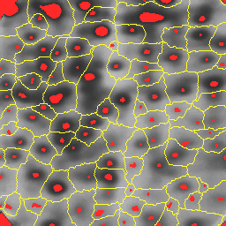
Electrophoresis gel image
marker-controlled watershed of the gradient image.

Slide 7
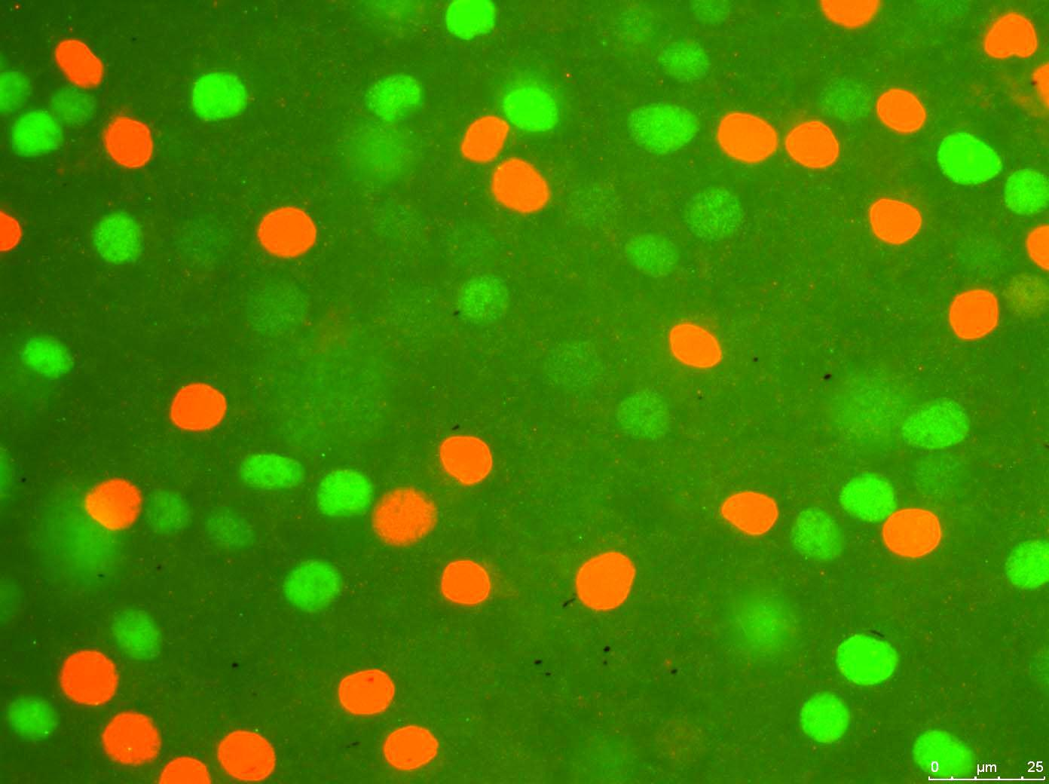
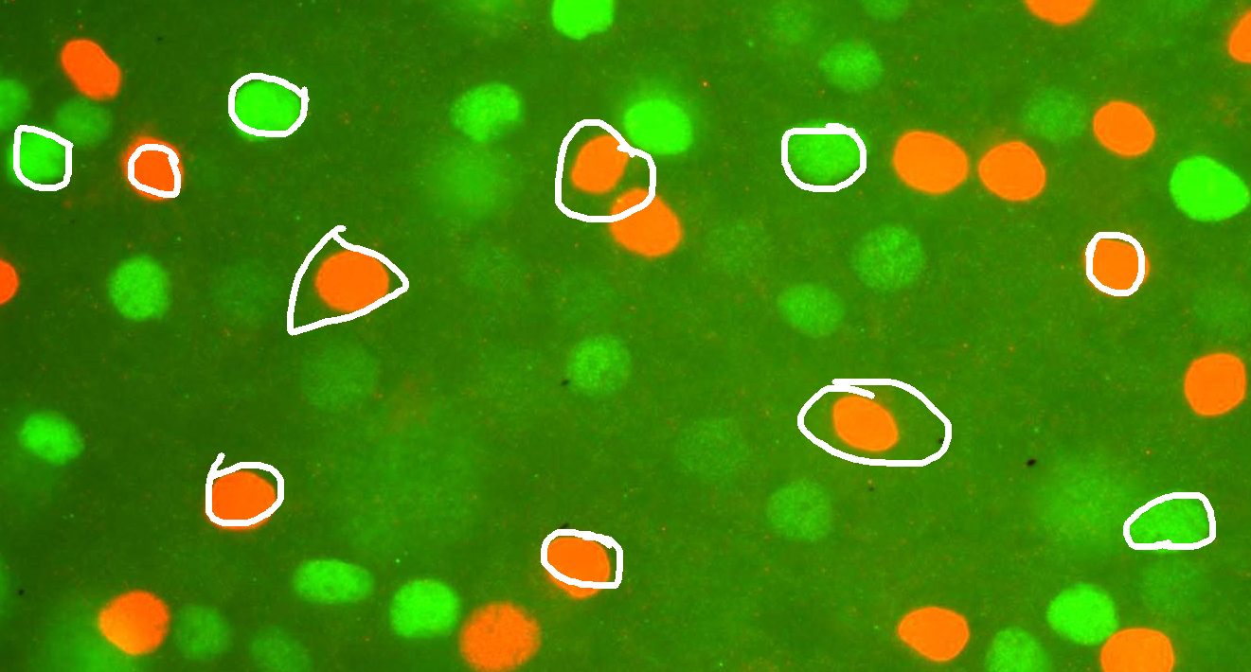
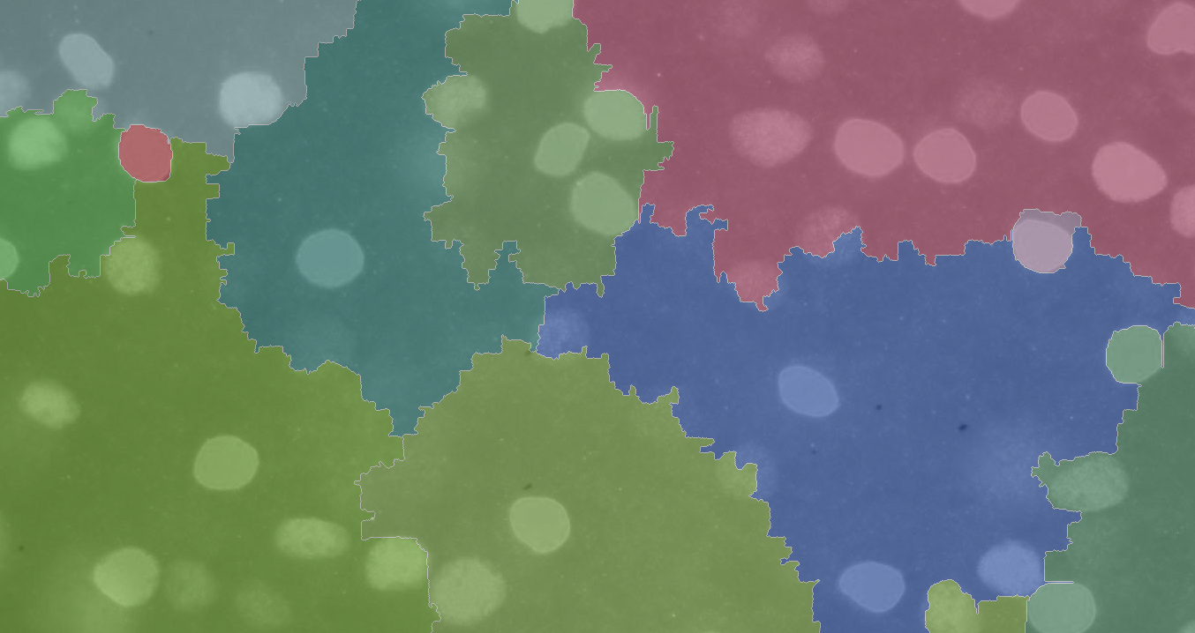
Work flow of the Watershed Algorithm

Slide 8
Workflow
Image should be given as input
Given image is converted to grayscale image for threshold
Threshold image should be marker labelled
Marker image should be segmented
Result Count of cells (or closed structures)

Slide 9
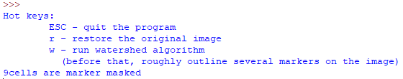
Output

